Slide 1
Development of master curricula for natural disasters risk management in Western Balkan countries
NatRisk project
Impact of NatRisk on the Western Balkan HEIs
Emina Hadžić, Faculty of Civil Engineering University of Sarajevo
Chania, Greek, 05.09.2018.
Project number: 573806-EPP-1-2016-1-RS-EPPKA2-CBHE-JP
"This project has been funded with support from the European Commission. This publication reflects the views only of the author, and the Commission cannot be held responsible for any use which may be made of the information contained therein"

Slide 2
Impact of NatRisk on the UNSA
Development of master curricula for natural disasters risk management in Western Balkan countries
Impact of NatRisk project will be achieved through a several different levels:
At local level (KS)
At insitutional level (UNSA)
At national level (BiH)
At EU level

Slide 3
At local level:
Development of master curricula for natural disasters risk management in Western Balkan countries
Arise the awareness about the importance of improving knowledge and skills in NDRM: All target groups (students, teaching staff, members of public sector actively involved in reducing of disaster risks and citizens who want to improve their knowledge and practical skills applicable in natural disasters situations) will be reached by dissemination tools such as delivering promotional materials to students and citizens, website, social and digital media. This kind of informing will arise the awareness about the importance of improving knowledge and skills in NDRM.
Teaching staff will be in direct contact with the representatives of local public sector in NDRM to analyse their needs for improvement of current system of NDRM, transfer acquired latest knowledge and sign protocols for students’ internships. - We make promotion about project and a new master curricula through meetings at local (Cantonal) level, et the conferencies , etcs...
Substantial project effect will be achieved by students’ involvement in gaining theoretical and practical knowledge in NDRM that can be applied immediately after the graduation.

Slide 4
At institutional level:
Development of master curricula for natural disasters risk management in Western Balkan countries
At UNSA will increase educational potential by implementation of new master study programmes,
improved teaching staff skills through acquiring up-to-date knowledge and adopted new pedagogical methods in teaching and learning,
upgraded laboratories with appropriate hardware and software infrastructure for analysis and simulation natural disasters and the new library units.

Slide 5
Development of master curricula for natural disasters risk management in Western Balkan countries
At national level:
the cooperation between UNSA and representatives of national bodies and agencies for environmental protection
will be settled on the way that have to impact on national efforts for developing
the system of national protection by establishing
institutional, organizational and personal conditions for the implementation of the protection in the emergency situations.

Slide 6
At European level:
Development of master curricula for natural disasters risk management in Western Balkan countries
UNSAwill benefit the rich experience of EU HEIs in NDRM forming new master curricula.
Students from UNSA will be included in realization of mobilities between WB and EU partner HEIs. The teaching staff will be involved into the teaching trainings into EU partner countries through the study visits.
The EU teaching staff and students will be also in position to apply their knowledge to the specific cases in WB region, and BiH, enriching in that way their experience.
The UNSA with such trained staff in line with EU standards and directives in NDRM will contribute to recommendation of European Forum for Disaster Risk Reduction (“create a safer Europe by reducing the impact of natural hazards to reduce vulnerability, and increasing the ability to minimize consequences of disasters”).

Slide 7
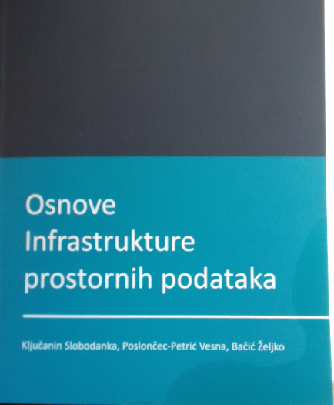
Making a new book for NatRisk students

Slide 8
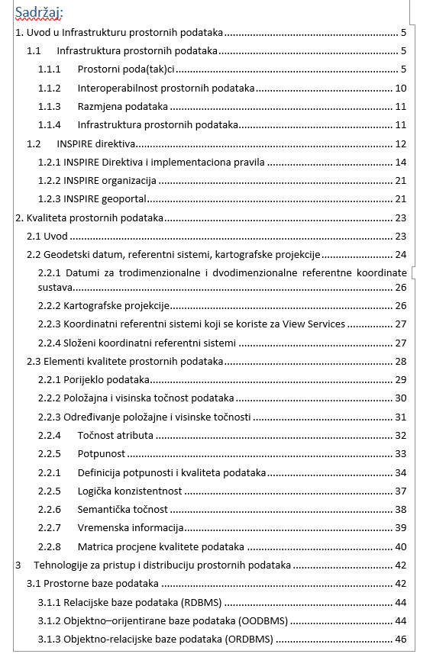
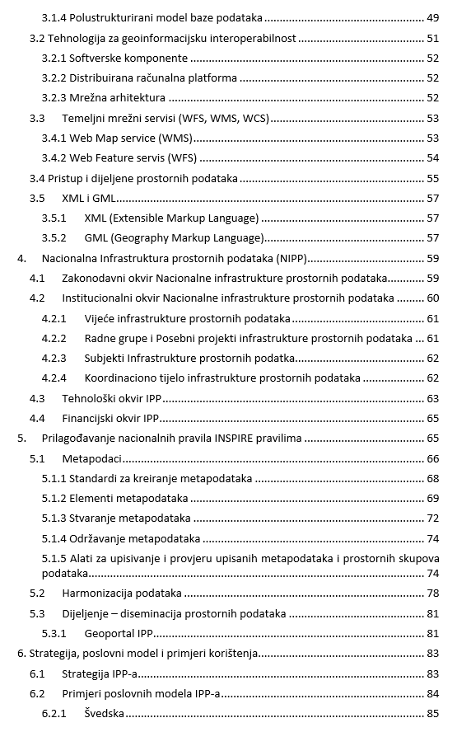

Slide 9
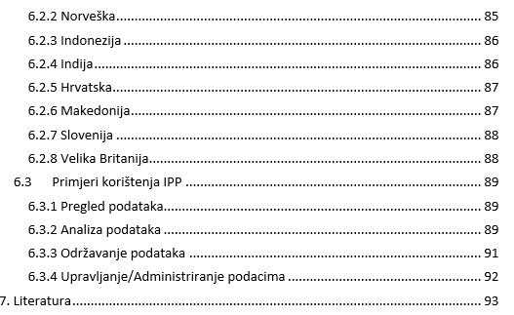

Slide 10
Thank you for
your attention!!!

